Slide 1
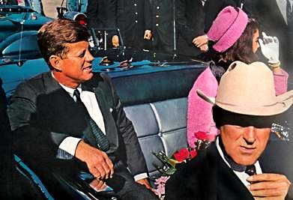
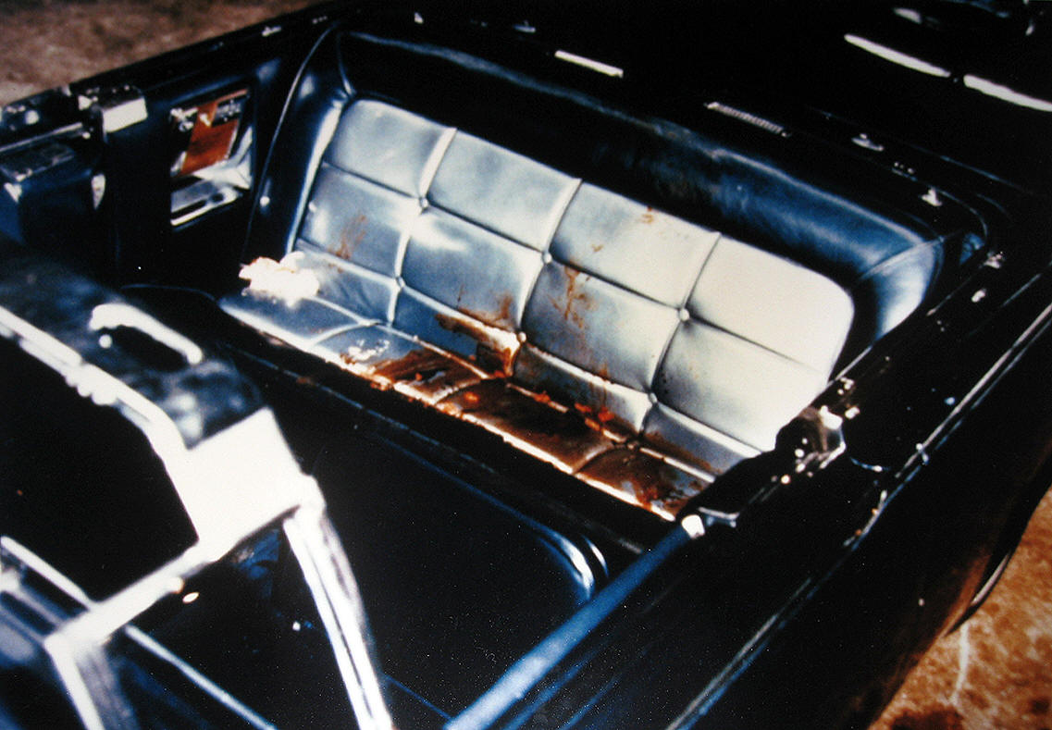
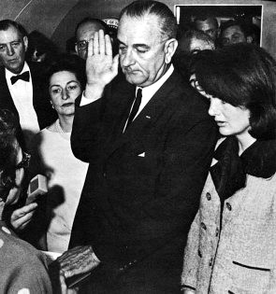
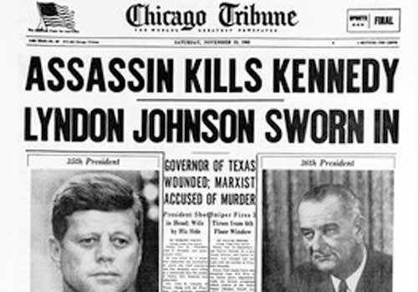
JFK Assassination Nov 1963 - Dallas

Slide 2
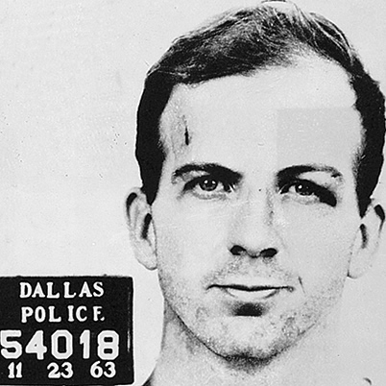
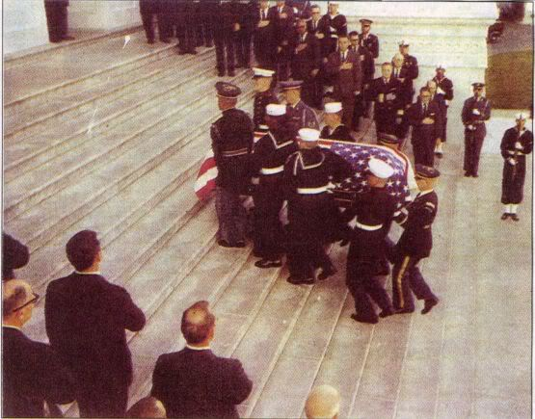
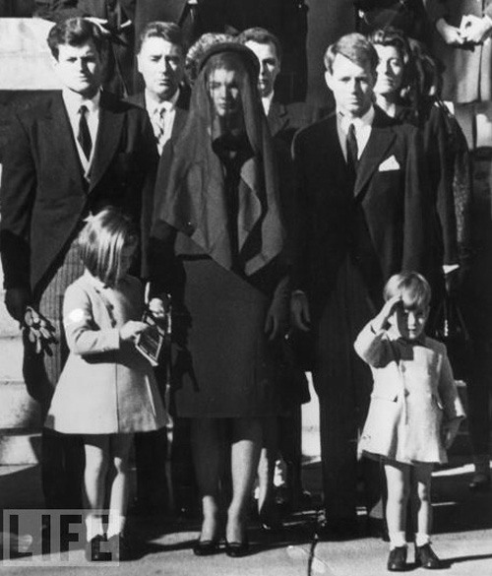
Now what?
Camelot Over?

Slide 3
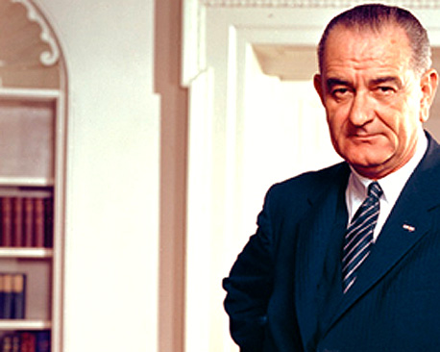
LBJ 1963-1968
I. Assassination of JFK & Election of 1964
II. Domestic Policy – Great Society
Civil Rights
III. Foreign Policy
Vietnam Escalation
Antiwar Movement
IV. Roaring ‘60s:
-Warren Court
-Civil Rights
-Sex, Drugs, RocknRoll

Slide 4
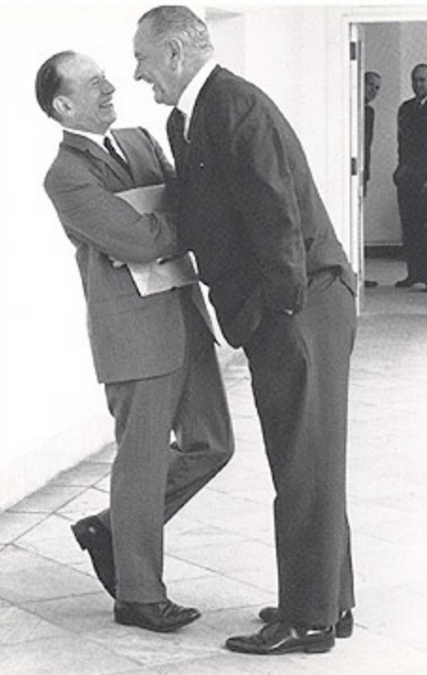
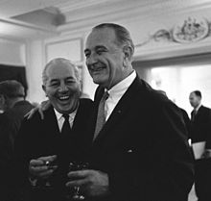
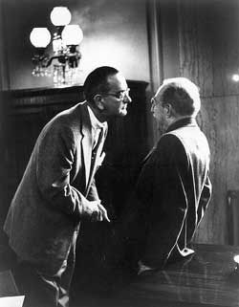
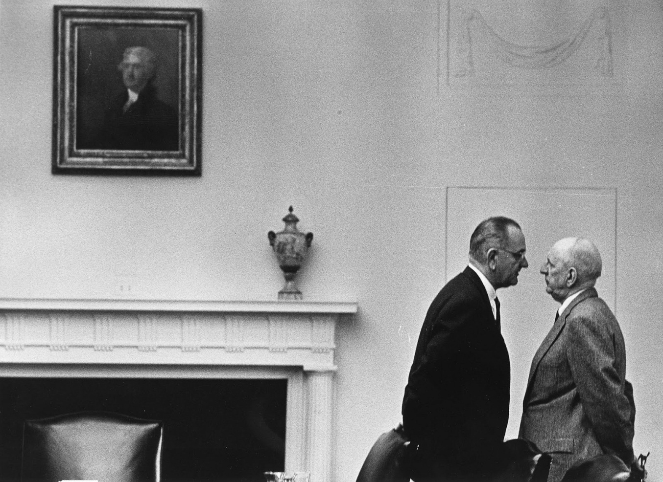
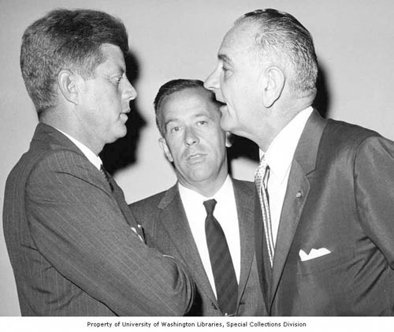

Slide 5
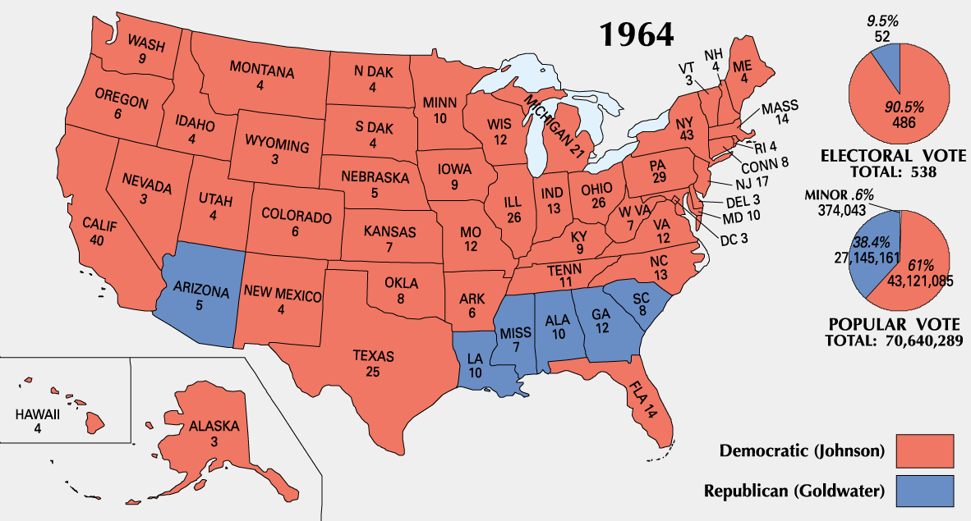

Slide 6
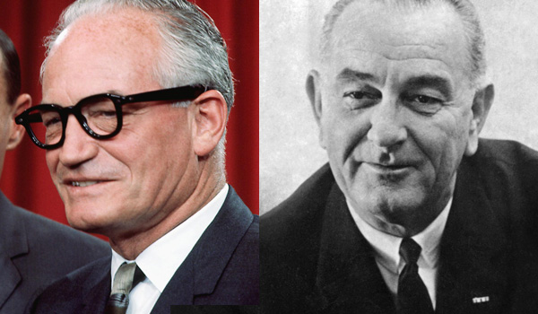
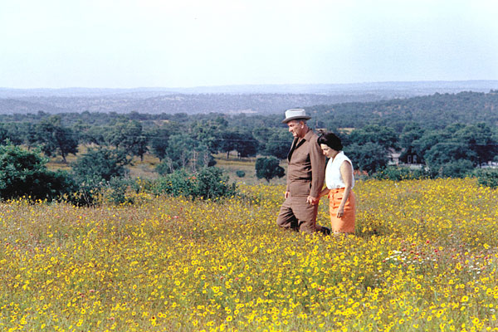
1964 Election Goldwater (R) vs. LBJ (D)
Core values of
Conservatism:
Militant anticommunism
Religious traditionalism
Commitment to historically normative roles for men and women
Temper funding for social programs
Core values of liberalism
Advocate working class and unions
Government activism to help poor
Commitment to racial justice and equal opportunity
Poor people are poor because of structural inequalities
1960s Central Tension:
Liberty vs. Equality
(Which one easier to equate
With communism?)

Slide 7
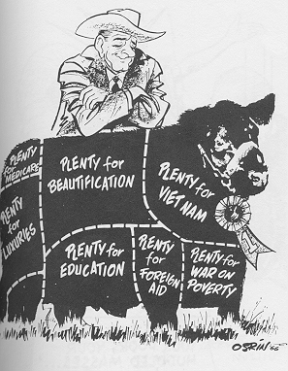
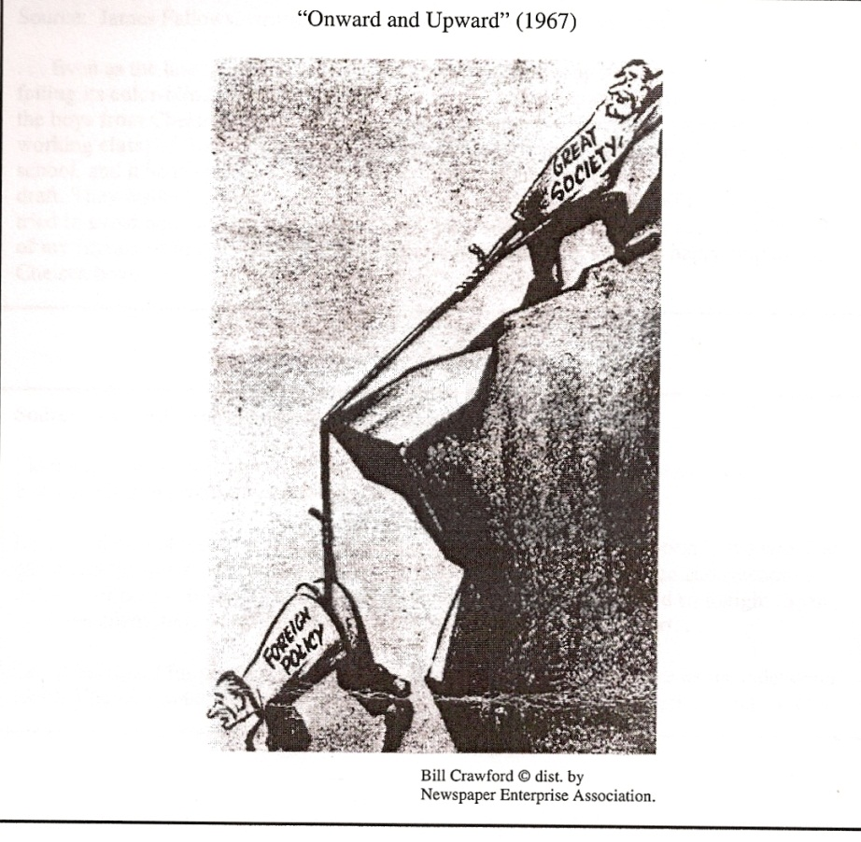
LBJs Great Society
Catalyst: Michael Harrington's The Other America
Catalyst: Silent Spring
Office of Economic Opportunity
Medicare
Medicaid
National Foundation for the Arts
Immigration
Education
Public Housing
“War on Poverty”
Environment

Slide 8
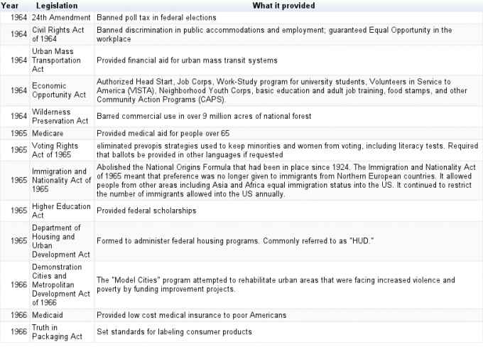

Slide 9
LBJ Foreign Policy Scorecard
VIETNAM EVENT | SIGNIFICANCE
TONKIN GULF RESOLUTION (1964) | Congress gives President war powers to commit troops to Vietnam. Hawks vs. Doves
OPERATION ROLLING THUNDER (1965,66,67) | Escalation! Forces White House to brainstorm how they measure success vs. guerilla warfare????
LBJ (November 1967) | “I am very encouraged….We are making real progress. We have reached an important point where the end begins to come into view” And then Tet…
TET OFFENSIVE (1968) | USA wins the battle against Vietcong attack USA loses the press/media/public opinion

Slide 10
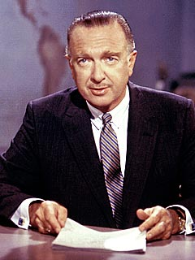
Walter Cronkite on February 27, 1968
“To say we are closer to victory today is to believe, in the face of evidence, the optimists have been wrong in the past. To suggest that we are on the edge of defeat is to yield to unreasonable pessimism. To say that we are mired in stalemate seems the only reasonable, yet unsatisfactory conclusion.”
LBJ - “If we have lost Cronkite, we have lost the war.”
John Kerry: “How do you ask a man to be the last man to die for a mistake?”

Slide 11
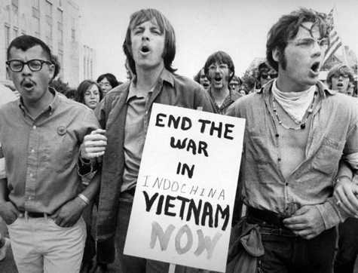
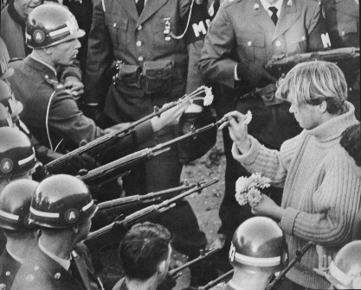
Hue, 1968 “a strategy of more of the same is intolerable.” Newsweek

Slide 12
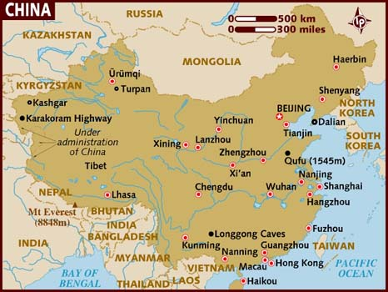
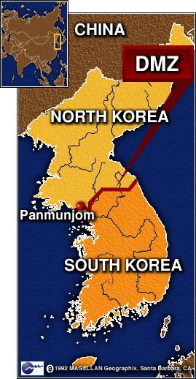
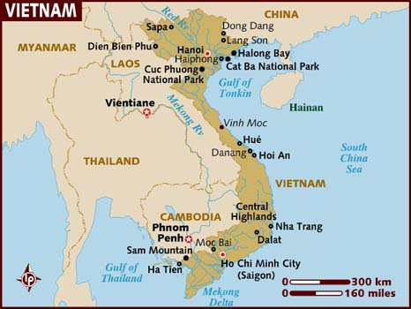
2004 FRQ Prompt
“Assess the success of the Doctrine of Containment in Asia between 1945 and 1975.”
CHINA
KOREA
VIETNAM

Slide 13
Thesis (yay or nay?)
Although the policy of containment failed completely with regard to China, and although its blank slate application in areas like Vietnam tarnished America’s judgment as a super power nation, containment successfully averted nuclear war and checked the global balance of power. (7)
In Korea, the communists were stopped but in Vietnam, communism prevailed resulting in a tragedy for Americans and a failure in the policy of containment of communism. (6)
However, even though China and Vietnam were failures, the United States interferences showed the world that the United States would not allow communists to expand without a fight. (5)

Slide 14
Sample FRQ – HW For Next Class!
(2010B) Analyze the effects of the Vietnam War on TWO of the following in the United States in the period 1961-1975:
The presidency
The population between 18 and 35 years old
Cold War diplomacy

Slide 15
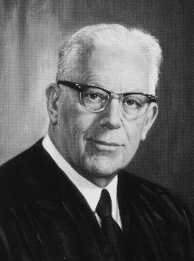
Warren Court
EXPRESSION & PRIVACY
INDIVIDUAL RIGHTS
Yates vs. US (1957): First Amendment protects radical speech
Engel vs. Vitale: Separation of church and state – prayer in school violated 1st amendment
Griswold vs. Connecticut: state cannot prohibit use of contraceptives; violates privacy
Gideon vs. Wainwright: Courts must provide lawyer despite not being able to pay for one.
Miranda vs. Arizona: right to remain silent and lawyer present during questioning
Creeping Liberalism…..

Slide 16
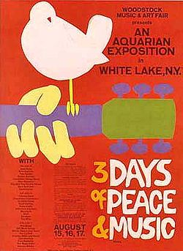
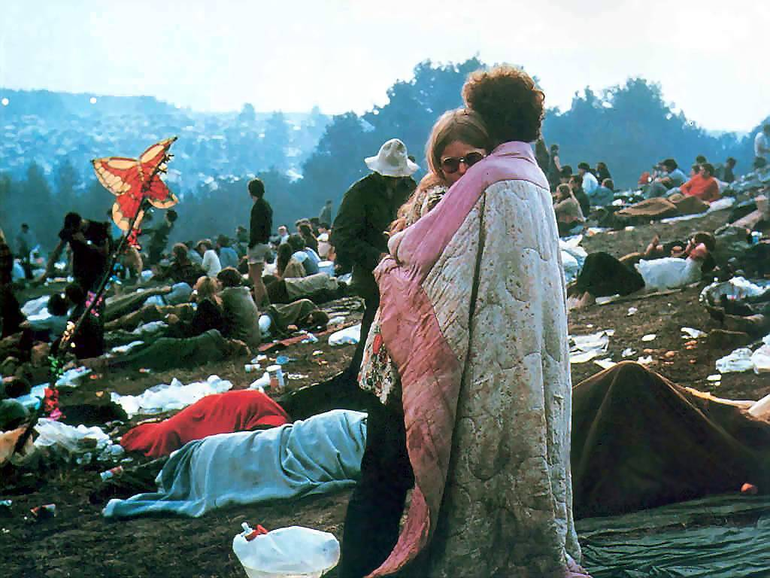
Woodstock 1969

Slide 17
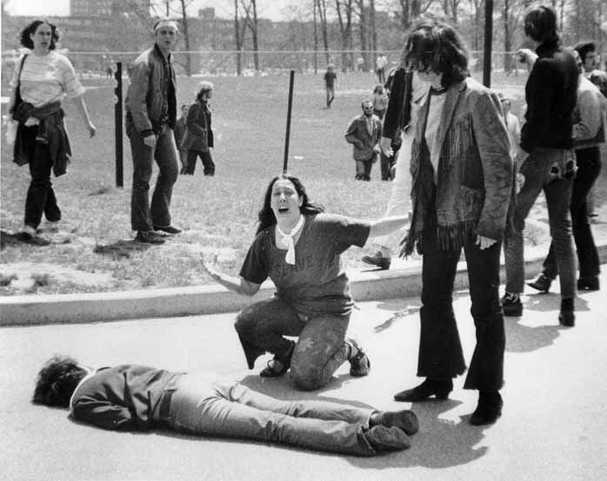
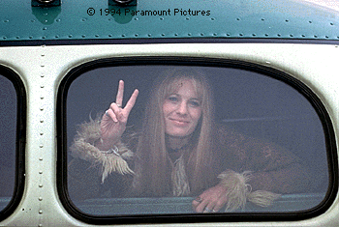
New Left / Student Movement
Port Huron Statement (1962)
Sexual Revolution
Students for a Democratic Society
All university decisions must be made through participatory democracy
Free Speech Movement at UC Berkley
Betty Freidan’s Feminine Mystique
NOW (1966)
ERA (Equal Rights Amendment; missed 38 votes for ratification)
Creeping Liberalism…..

Slide 18
“Black Power” (1965 – 1970)
Bloody and destructive riots:
Watts, Detroit, Harlem, Newark
Effect on Whites: paranoia
New Leadership
Black Panthers
Black Muslims

Slide 19
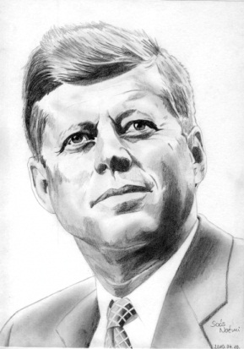
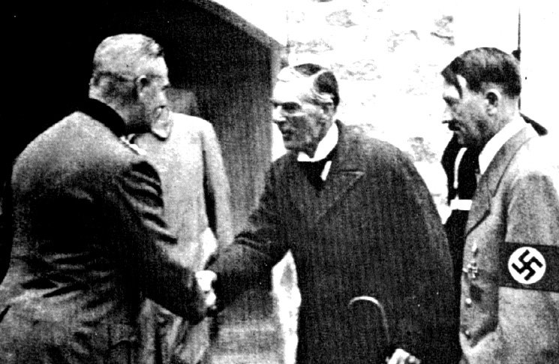
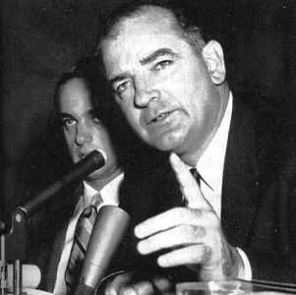
GHOSTS OF 1968
Melancholy over dead JFK, vulnerability, disillusionment
Scapegoating: Who are the subversives that continue to create chaotic & unstable society?
Fear of appeasing enemies; don’t look soft

Slide 20
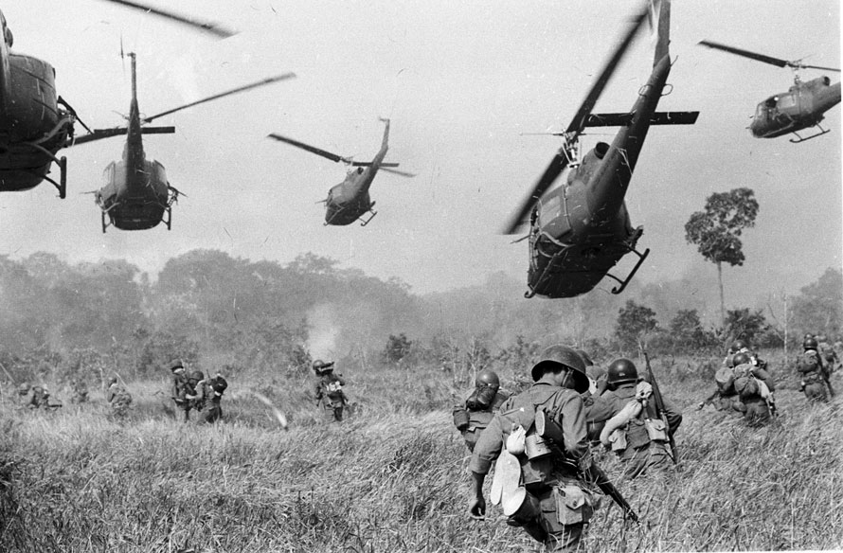
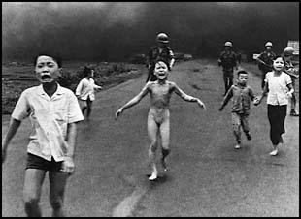
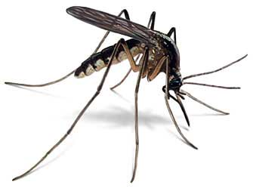
3 Mosquitos
Assassination
Racial
Violence
Counter-
CULTURE

Slide 21
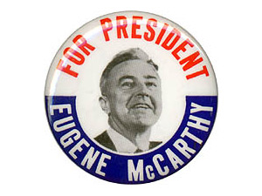
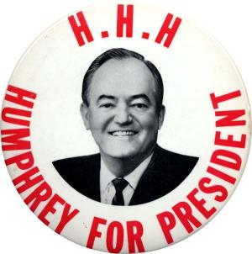
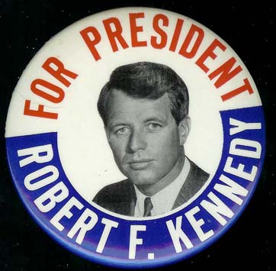
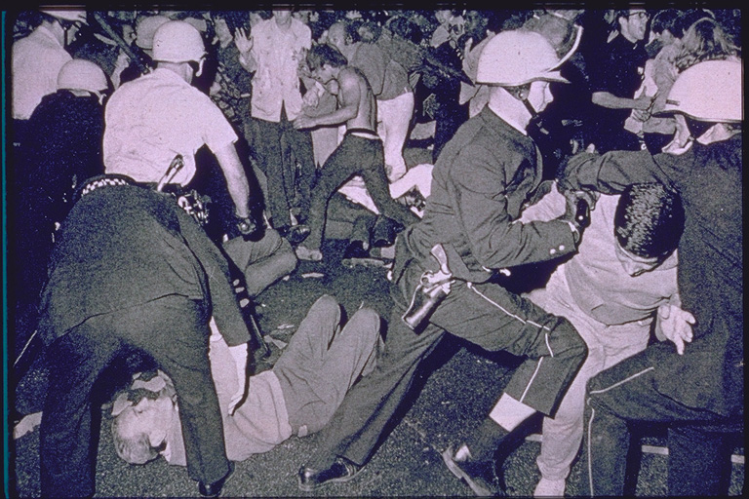
1968 Election: Democratic Convention THE CANDIDATES

Slide 22
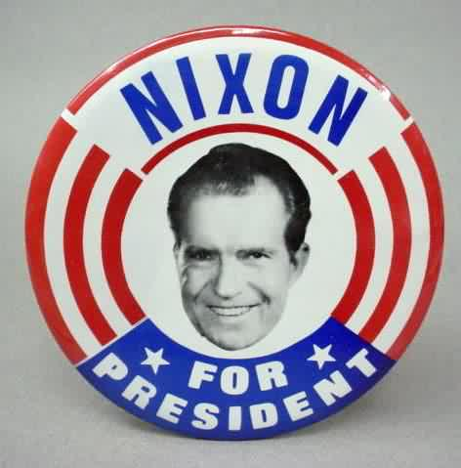
Nixon wins “SILENT MAJORITY”**
Law and order
Tough on crime
Stability
Appealed to south (whites view blacks as troublemakers, rioters)
Peace with honor in Vietnam
** Elected as the representative of middle America - those middle class citizens fed up with the liberal politics and promises of the 1960s.
Wins by less than 1%, even though Democratic Party was in disarray

Slide 23
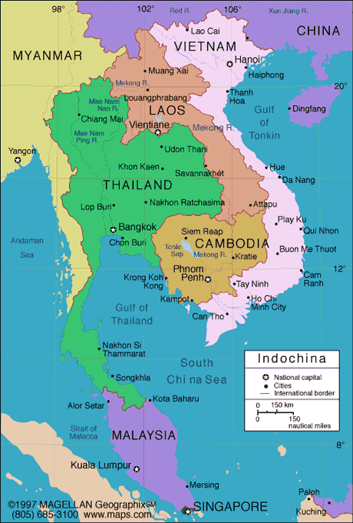
VIETNAM DURING NIXON YEARS
Disillusionment with war:
(Not directly Nixon’s call)
Disillusionment with war:
(Directly Nixon’s call)
Mai Lai Massacre (‘68): US Army wiped out Vietnamese village. Media uproar.
Kent State: 4 die and 19 injured on campus for protesting war.
Pentagon Papers: (‘71) Details strategic failures – published as series in newspapers
Decision to expand war into Cambodia.
Ho Chi Minh Trail

Slide 24
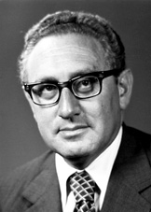
FOREIGN POLICY STRATEGY
KISSINGER
Born in Germany, Harvard
Secretary of State
DETANTE: relax relations with USSR and China. De-escalate.
Shanghai Communique
PING PONG DIPLOMACY: Middle East: Yom Kippur War + Diplomacy with China after Sino-Soviet Split.
REAL POLITIK:
Power over principles
Ideology is not what motivates people. People and governments think/act pragmatically based on needs and balance of power.

Slide 25
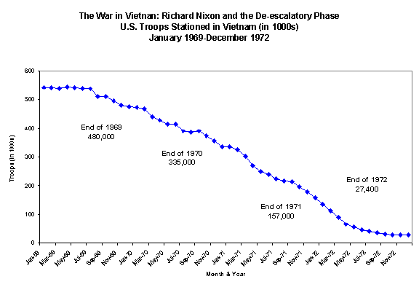
Nixon and Vietnam “peace with honor”

Slide 26
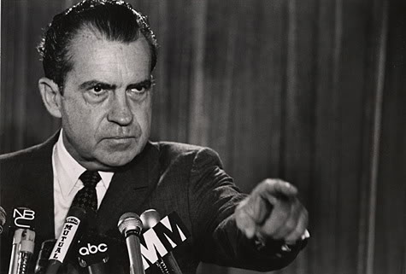
Watergate - What did Nixon do wrong? Nixon's Abuses of Government/Presidential Power
1. He used government agencies (FBI, CIA, IRS, FCC) to spy on and harass his critics
2. He ordered illegal wiretaps placed on newspapers and government employees
3. He used his "plumbers" to try to discredit Daniel Ellsberg (who had leaked the Pentagon Papers) and to try to prevent leaks to the press
4. He used his "plumbers" to attempt to plant a wiretap on the phone of the Democratic National Committee in the Watergate Office complex and to play other "dirty tricks" during the 1972 campaign
5. He authorized the payment of hush money to the Watergate burglars
6. He attempted to cheat on his income tax
7. He used government money to renovate his homes
8. He refused to obey Congressional subpoenas of the Oval Office tapes & tried to ignore decisions of the Supreme Court

Slide 27
Evaluating President Nixon
+’s
President Nixon was a great President because…
• Visionary in Foreign Policy
• Détente & SALT
• China
• EPA
• Ended Vietnam (without a civil war)
-’s
President Nixon was a terrible President because…
• Pledged to restore truth & openness & bring Americans together - Failed
• Watergate
• Expanded Vietnam (Cambodia)

